Slide 1
RAJALAKSHMI ENGINEERING COLLEGE
Department of Information Technology
FINAL REVIEW
IOT BASED SMART HELMET FOR INSPECTING AND REPORTING AIR QUALITY AND HAZARDOUS EVENT DETECTION FOR MINING INDUSTRIES
Project by,
KEERTHANA G - 191001034
KRITIKA MAHESWARAN - 191001036 KUZHALI S - 191001037
LAKSHMI PRIYA R - 191001038
Supervisor
Ms. S.Usha (Associate

Slide 2
OUTLINE
Abstract
Introduction to Problem Domain
Existing system
Limitation of the Existing System
Proposed system
Architectural design for Proposed system
Data Flow Diagram
Algorithm/Technique Used
Expected Outcomes
References

Slide 3
ABSTRACT
To identify potentially dangerous situations in the mining area, a conventional smart helmet model will be created
The three main types of hazard such as air quality, helmet removal, and collision are taken care of
The first is the presence of the hazardous gases such as CO,SO2,NO2 and particulate matter
The second hazardous event was classified as a miner removing the mining helmet off their head. IR sensor was then used to successfully determine when the helmet is on the miner’s head
The third hazardous event is defined as an event where miners are struck by an object against the head with a force.

Slide 4
EXISTING SYSTEM
Presently mining safety helmet only have the purpose of protecting the miner’s head against potential hazardous bumps
The safety helmets do not have any technology added to it. In recent years, harvesting technology has played an important role in the area of mine applications
The literature on mines technology is available but very limited
There is no implementation of smart helmet in the real-time mines but some research projects proposed the concept of the same with Bluetooth technologies were Bluetooth have several disadvantages of connectivity and power supply
Not more accurate
Hazardous gases affects the human

Slide 5
PROBLEM STATEMENT
To implement an IoT based smart helmet for inspecting and reporting air quality and hazardous event detection for mining industries
Occurrences of accidents in the construction and mining sites are usually a part of the news
Nowadays, it has become mandatory to wear protective helmets at such sites. But these helmets can prevent the head from crashing against objects, but are helpless against fire and similar accidents
In this context, there is a grave danger to the lives of people working in those sites. Most of the contractors and workers take proper care in working at these places. But still there are such incidents where the human lives are in danger. This is a question that wants to be answered

Slide 6
PROPOSED SYSTEM
The system provides real time monitoring of mines from base station. The transmitter unit is placed on helmet of worker and receiver unit placed on the base station
The IOT based wireless technology is used for data transmission from coal miners to the base station. The Wifi communication network provide two way communication means from base station to mines and from mines to base station
The transmitter unit consists of air quality sensor, helmet removal sensor and person fall detection sensor If any abnormal action are detected gps location will send to iot web server
A smart mining helmet was developed that is able to detect three types of hazardous events such as danger level of hazardous gases, miner helmet removing, and collision or impact
More accurate

Slide 7
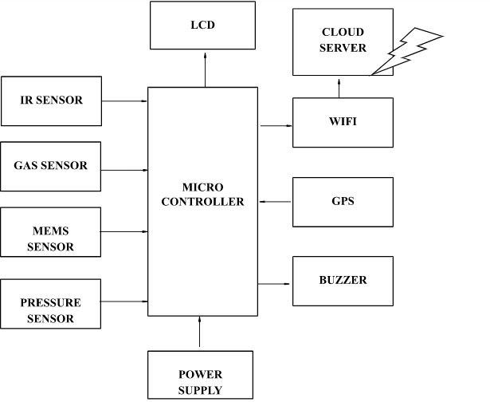
ARCHITECTURAL DESIGN FOR PROPOSED SYSTEM

Slide 8
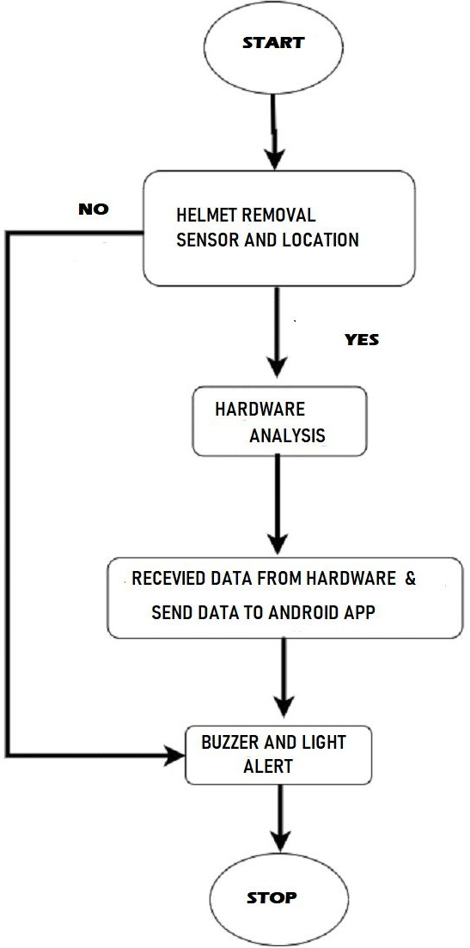
DFD DIAGRAM

Slide 9
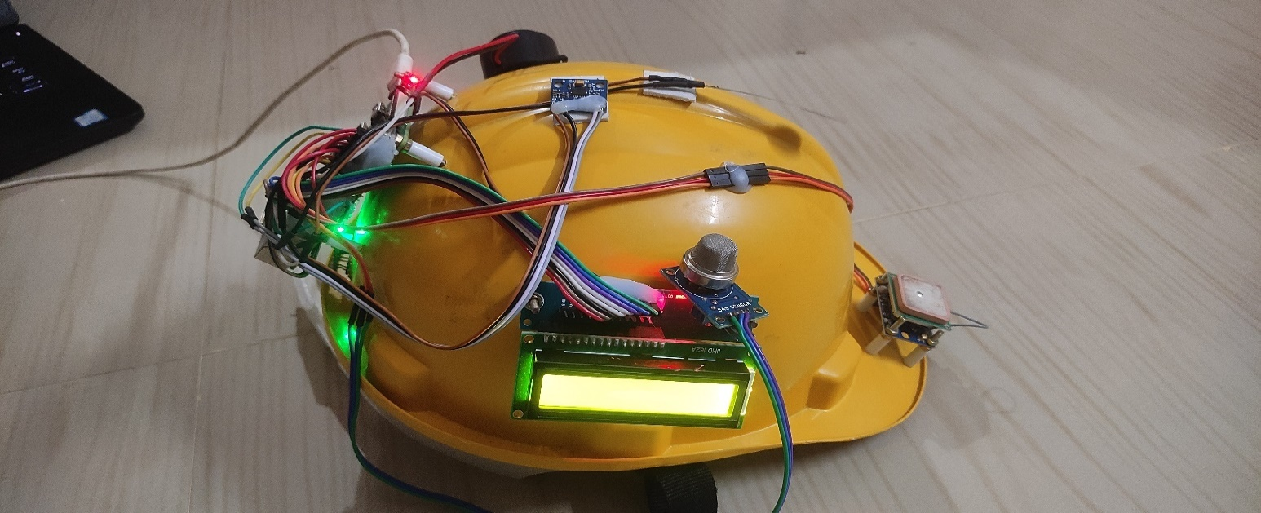
HELMET IMAGE

Slide 10
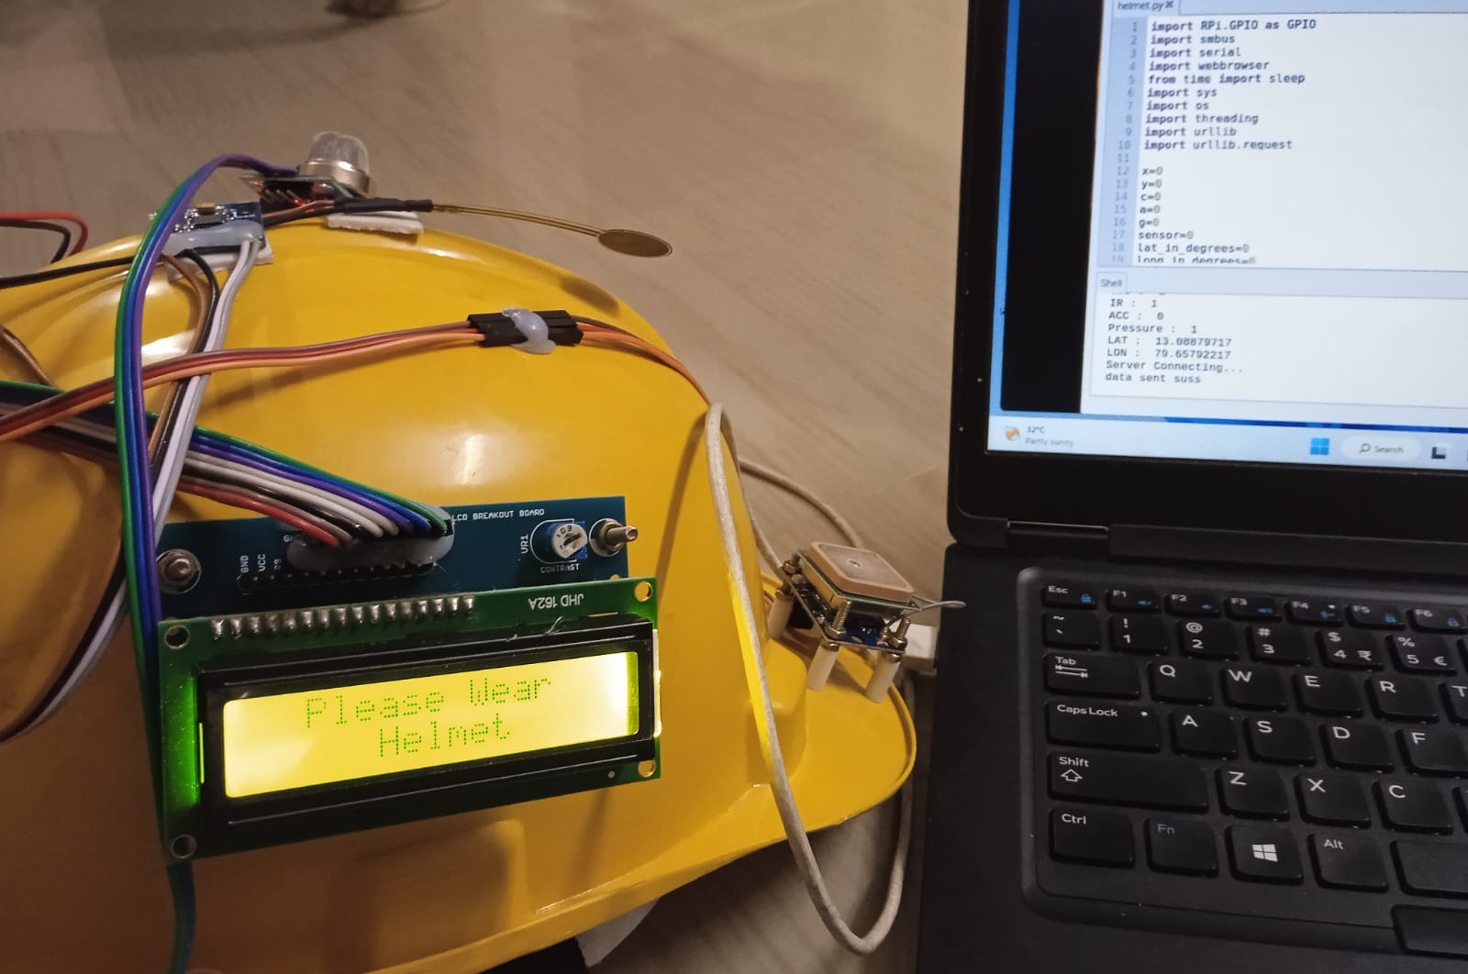
BEFORE ACCIDENT
DETECTED

Slide 11
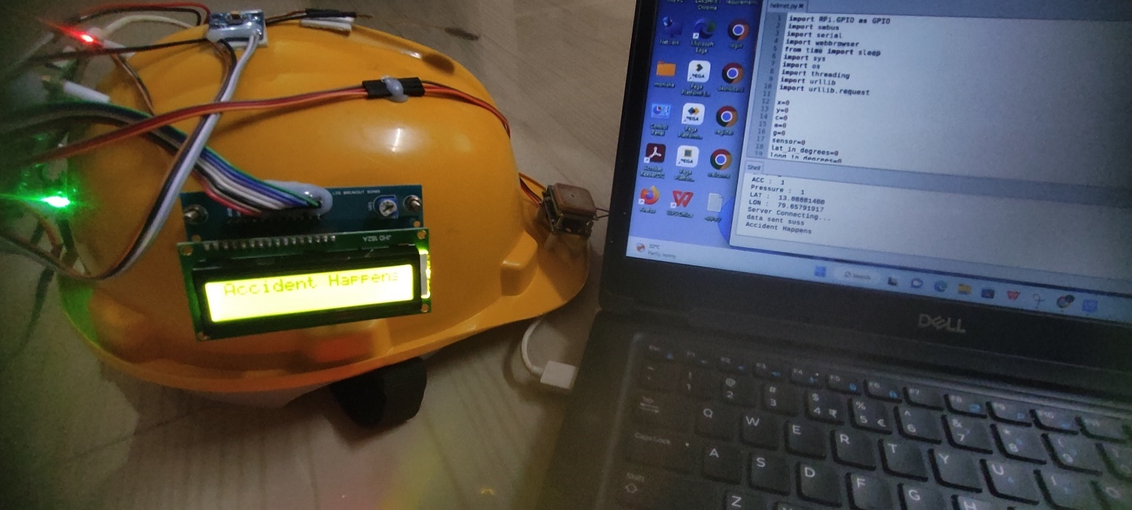
ACCIDENT DETECTED

Slide 12
REFERENCES
[1]. http://www.makeinindia.com/sector/mining
[2]. D. Kock and J. W. Oberholzer, “The development and application of electronic technology to increase health, safety, and productivity in the South African coal mining industry,” IEEE Trans. on Industry Applications, vol. 33, no. 1, pp. 100-105, Jan/Feb. 1997.
[3]. CHENG Qiang, SUN Ji-ping, ZHANG Zhe, ZHANG Fan “ZigBee Based Intelligent Helmet for Coal Miners” World Congress on Computer Science and Information Engineering 2009
[4]. Shirish Gaidhane, Mahendra Dhame and Prof. Rizwana Qureshi “Smart Helmet for Coal Miners using ZigBee Technology” Imperial Journal of Interdisciplinary Research (IJIR) Vol-2, Issue-6, 2016 ISSN: 2454-1362
[5]. Kumar and G. P. Hancke, “Energy efficient environment monitoring system based on the IEEE
802.15.4 standard for low cost requirements”, IEEE Sensors Journal, vol. 14, no. 8, pp. 2557-2566, Aug. 2014.
[6]. “Head and neck injury criteria a consensus workshop” Research information and publications center. University of Michigan transportation research institute.
[7]. H. Hongjiang and W. Shuangyou, “The application of ARM and ZigBee technology wireless networks in monitoring mine safety system,” IEEE International Colloquium on Computing, Communication, Control, and Management (ISECS 2008), 3-4 Aug. 2008, Guangzhou, pp. 430–433,
200

Slide 13
THANK YOU

